Slide 1
What to do in Case of an Asthma Attack
Essential information for educators who assist the 7% of Utah school students who are diagnosed with asthma
Notes:
Introduce yourself (be excited to be there!)
This version of the presentation is designed for school nurses to use and adapt for about a 10 minute presentation to educators.
The Utah State Dept. of Health asthma program has an asthma resource book and laminated asthma action posters available for schools.
Explain that you are here because the asthma burden for school children is an important public health issue in Utah and educators need to be prepared to help students with asthma. Over 59,000 children in the State have asthma.

Slide 2
What is Asthma?
A chronic lung disease that can make it hard to breathe
Three things happen to make breathing difficult:
Airways fill with mucus
Airway linings swell
Muscles around airways tighten
Notes:
Three things occur in the airways going to the lungs which makes breathing difficult:
Airways in the lungs fill with mucus (in the bronchial tubes)
Airway lining (in the bronchial tubes) swells, and
Muscles around the (bronchial tubes) airways constrict

Slide 3
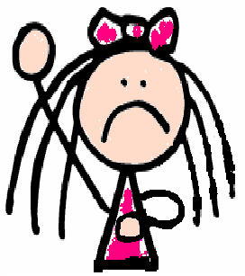
Signs and Symptoms
People with asthma often experience periods of:
Shortness of breath
Wheezing
Coughing
Chest tightness
Appearing fearful or worried
Lack of energy
Irritable
Stuffy, runny nose
Retractions
Nasal flaring
These periods are called attacks or episodes and should always be taken seriously
Notes:
As previously explained, signs and symptoms vary from person to person, but a few general signs and symptoms include:
Hint: Ask a faculty member with asthma, how they feel during an asthma attack.
Wheezing: A whistling sound while breathing
Retractions: A person is struggling to breath so that the belly sucks in and you can see their ribs. The skin also sucks in against the collarbone
Nasal flaring: In efforts to breathe.
Nausea and vomiting
Fatigue: Quickly tires

Slide 4
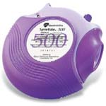
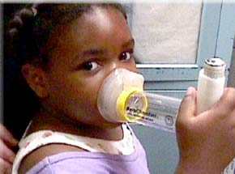
Is there a cure?
No cure, but it can be controlled
Someone with controlled asthma can live a normal life
Asthma can be controlled by:
Knowing and avoiding common triggers
Appropriate use of medications
Controller Medications
Long-term: taken on a daily basis to reduce swelling and mucus.
Quick-Relief “Rescue” Medications
Short-term: taken in emergencies or when exposed to triggers (e.g. inhaler).
Notes:
Many people ask, Is there a cure for this disease, or what causes it? At this point we don’t know, there is evidence of some causal associations, for example, asthma tends to run in families, so there is a genetic piece, we also know that the environment and lifestyle are factors, but how these interact and to what degree, that is still not known.
And is there a cure? As of right now, there isn’t, but those with asthma can live a very normal lifestyle if the disease is properly controlled.
Most individuals with asthma should have two types of medications.
One, is a controller medication and is taken daily to reduce swelling and mucus.
The second, is the inhaler, or the quick-relief “rescue” medication, and is with what most people are familiar. The inhaler is used for multiple purposes, 1)to pre-medicate before an athletic event IF, EIA is a trigger, 2)if exposure is unavoidable to a trigger, or 3)other times when asthma episodes are being experienced.
Point out that students using a rescue inhaler more than a few times a week are not under control and probably need to take a controller medication prescribed by a health care provider.

Slide 5
Common Triggers
Extreme temperatures
Exercise
Air pollution
Animals, pests
Pollen
Strong emotions
Strong odors
Tobacco smoke
Dust
Mold
Respiratory infections
Notes:
A trigger is something that can initiate asthma symptoms, that influences the way air is exchanged. We will talk about triggers generally, but it’s important to remember that triggers vary from individual to individual. Symptoms can be reduced by avoiding an individual’s triggers.
Hint: "Ask the group what some of the environmental triggers are at their school and have a discussion (chemicals, mold, fragrance, etc.)”
It is not necessary to go into detail about all the triggers but this information is provided to educate the presenter.
Strong emotions: When you experience strong emotions -like anger, fear or excitement- your breathing changes, even if you don’t have asthma. When a person with asthma laughs, yells, or cries hard, natural airway changes may cause wheezing or other asthma symptoms.
Mold: Molds create tiny spores to reproduce, just as plants produce seeds. Mold spores float through the indoor and outdoor air continually. When mold spores land on damp places indoors, they may begin growing. For people sensitive to molds, inhaling mold spores can trigger an asthma attack.
Cockroaches: Droppings or body parts of cockroaches and other pests can trigger asthma. Certain proteins are found in cockroach feces and saliva and can cause allergic reactions or trigger asthma symptoms in some individuals.
Dust Mites: Dust mites are tiny bugs that are too small to see. Every home has dust mites. They feed on human skin flakes and are found in mattresses, pillows, carpets, upholstered furniture, bedcovers, clothes, stuffed toys and fabric and fabric-covered items. Body parts and droppings from dust mites can trigger asthma in individuals with allergies to dust mites.
Exercise: Exercise and other activities that make you breathe harder. Exercise—especially in cold air—is a frequent asthma trigger. A form of asthma called exercise-induced asthma is triggered by physical activity. Symptoms of this kind of asthma may not appear until after several minutes of sustained exercise
Animals: Proteins in your pet's skin flakes, urine, feces, saliva and hair can trigger asthma. Dogs, cats, rodents (including hamsters and guinea pigs) and other warm-blooded mammals can trigger asthma in individuals with an allergy to animal dander.
Weather/Cold Air: Some weather situations like extremely hot or cold temperatures, changes in barometric pressure or humidity, air quality , dry wind, cold air, or sudden changes in weather can bring on an asthma episode.
Tobacco smoke: Secondhand smoke is the smoke from a cigarette, cigar or pipe, and the smoke exhaled by a smoker. Secondhand smoke contains more than 4,000 substances, including several compounds that cause cancer.
Secondhand smoke can trigger asthma episodes and increase the severity of attacks.
Respiratory infections: Respiratory infections such as colds, flu, sore throats, and sinus infections are the number one asthma trigger in children.
Chemicals: Chemical irritants are found in some products in your house and may trigger asthma. Asthma may be worse around products such as cleaners, paints, adhesives, pesticides, cosmetics or air fresheners. Also, strong fumes or odors like household sprays, paint, gasoline, perfumes, and scented soaps can aggravate inflamed, sensitive airways
Bad Air Quality: Poor air quality can trigger an asthma attack. Bad air quality is especially a concern from November to February (Utah’s inversion season). The Utah Asthma Program has worked with the Department of Environmental Quality to develop guidelines, known as the Recess Guidance, for when students should remain indoors based on pollution levels.

Slide 6
Helping Students With an Asthma Episode at School
Notes:
It is a good idea to keep a copy of the Emergency Protocol for Schools in your classroom. It provides specific steps to take in case of an asthma attack.
It is divided into 3 zones: Green, Yellow, and Red
In the green zone, students do not show asthma symptoms
In the yellow zone, students are experiencing one or more asthma symptoms
The red zone is an asthma emergency. If the student is experiencing one or more symptoms described in the red zone, call 911 immediately.

Slide 7
Be prepared
Know which children have asthma
Be aware of any triggers
If possible, remove triggers from classroom
Be alert of symptoms
Know where the medicine is kept
Notes:
This slide describes what to do in the Green Zone.
Be prepared--
Know which students have asthma and where their medicine is kept.
Be alert for students who may have asthma symptoms. Symptoms can become progressively worse and lead to severe, even life-threatening asthma attacks. Treating symptoms promptly can prevent this and allow the student to resume school activities.
Be aware of the common indoor and outdoor triggers in the school environment:
-Cleaning supplies (especially aerosol sprays)
-Art supplies (strong odors)
-Dust mites
-Chalk or dry erase markers
-Exercise (Recess)
-any others?
It is important to identify and remove or minimize these triggers.

Slide 8
If a child has asthma symptoms and needs your assistance…
NEVER leave child alone
Stop the child’s activity
Help the child remain calm
Put the child in an upright, sitting position
Do not have the child lay down
Help the child locate quick-relief medicine
Assist as the child self-administers medication
Call parent or guardian
Repeat quick-relief inhaler medicine in 20 minutes if child is still having trouble breathing
Notes:
This slide describes what to do when a student is experiencing asthma symptoms (yellow zone)
Quickly evaluate the situation. Call 911 if the student has any red zone symptoms: struggling to breathe, talk, stay awake, has blue lips, or asks for an ambulance.
Never leave a student alone. Have an adult accompany the student to the health room or send for help from a school nurse designee. Do not wait.
Stop the student’s activity. If the episode began after exposure to an allergen or irritant, remove the student from the allergen or irritant, if possible. Help the student be calm and in a comfortable position.
Put the child in an upright, sitting position. Breathing is easiest while sitting up.
Help the student locate and take his/her prescribed quick relief inhaler medicine.
Contact parent/guardian
Repeat quick-relief inhaler medicine in 10-20 minutes if student is still having trouble breathing.

Slide 9
Call 911 if …
Child is struggling to talk, stay alert, or has blue lips, face, or fingernails
Child is having retractions
If quick-relief medicine is not available
If parent/guardian or nurse is not available
Student doesn’t improve after two uses of inhaler
If you are unsure of what to do
** Encourage parents to inform their
health care provider of serious episodes**
Notes:
These are signs of an asthma emergency (red zone). Remember to call 911 immediately if your student has any of these symptoms.

Slide 10
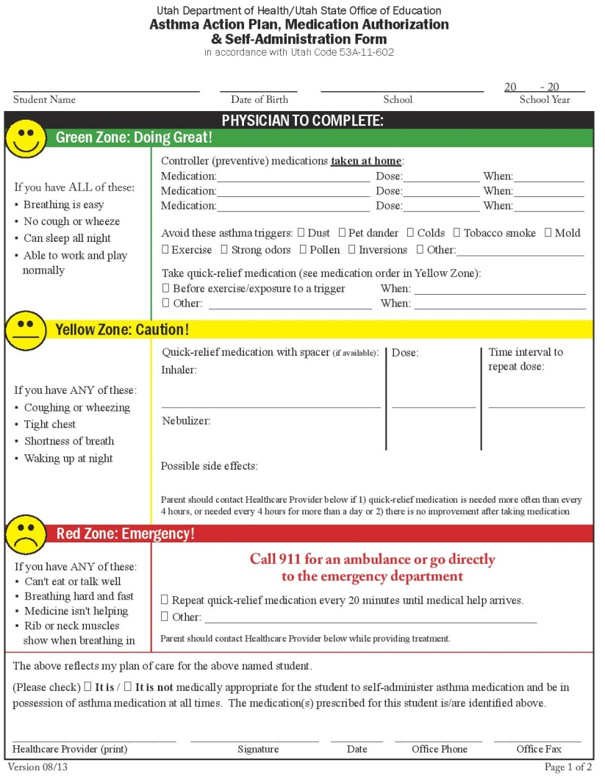
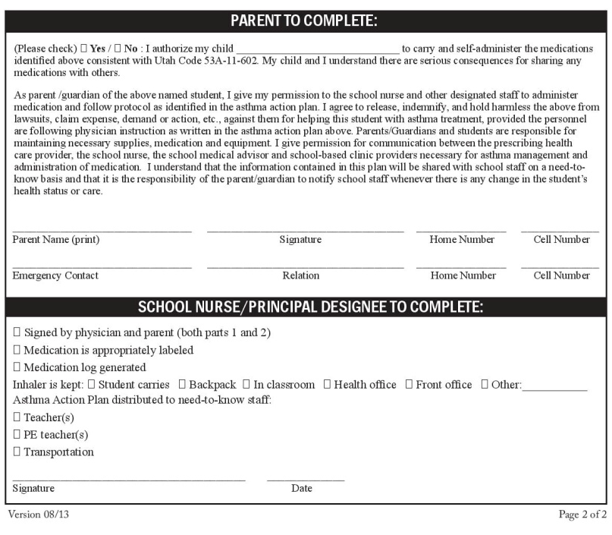
Asthma Medication Policy in Schools
Utah State Law allows children to carry and use inhaled asthma medications at school
Asthma Action Plan Form
- Signed by parents
Signed by health care provider
Kept on file at school
Identifies whether students self-carry inhaler or store at school and have adult help.
Notify your School Nurse!
Notes:
Utah Code 53A-11-602 states that if a student has an Asthma Self-Administration form turned in to the school office, the school must allow the student to carry and use their inhaled asthma medication.
The self-administration form is signed by the child’s health care provider and parent. The health care provider verifies that it is medically appropriate for the student to self-administer medication and provides the name, dose, and side effects of the medication.
This completed form is helpful in managing students with asthma in schools and should be turned in by parents to the nurse or office.
Notify your school nurse when an inhaler or a asthma action plan is brought to the school.

Slide 11
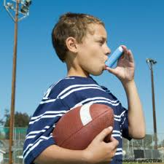
Know How to Use an Inhaler
http://www.youtube.com/watch?v=Rdb3p9RZoR4
How to Use an Inhaler with Spacer
http://www.youtube.com/watch?v=uJy97bTdGzI
Notes:
If you would like, go over the steps of using an inhaler. Point out that for children that using an inhaler with a spacer (chamber) is much more effective. Following are common mistakes when using an inhaler and basic steps to using an inhaler. Note that some doctors instruct patients to put the mouthpiece in their mouth and others recommend a position slightly outside the mouth when delivering the puff. Some students may use a nebulizer instead of an inhaler and that will take extra training and doctor’s orders.
Common reasons for poor technique in using inhalers
Not clearing mouth piece or not taking off cap
Not shaking
Failure to coordinate with inspiration
Inhale through nose and not mouth
Inhale too fast
Failure to breath-hold after dose
Cold freon effect- causes inhalation to stop
Holding MDI upside down
(From David Young, Pharm. D, University of Utah)
Basic inhaler technique
Shake
Remove cap
Prime (if 2+ weeks since last use)
Breath out
Inhale slowly, deliver puff right after inhalation starts.
Hold breath for several seconds
Wait one minute before second puff

Slide 12
Learn how air quality affects asthma
Check air quality before recess
Follow Utah Recess Guidelines
http://air.utah.gov/
Find current conditions for your county
Have a school plan in place which helps manage when students should stay inside for recess
Notes:
Schools should be aware of how air quality effects their area, especially in winter when particulate count may be high and in summer when ozone levels may be unsafe. The Utah Dept. of Health asthma program has resources to help schools understand and set protocol for poor air quality and outdoor recess.

Slide 13
Resources
Utah Asthma School Resource Manual
Utah Department of Health Asthma Program
http://health.utah.gov/asthma/schools/index.html 801-538-6894
Air Quality Conditions
http://air.utah.gov/
Recess Guidance: http://health.utah.gov/asthma/airquality/recess.html
Notes:
{Thanks also to the Salt Lake County Health Dept. for sharing some of their power point presentation with the Utah State Dept. of Health}

